Slide 1
Tech +
AEC Visualizations

Slide 2
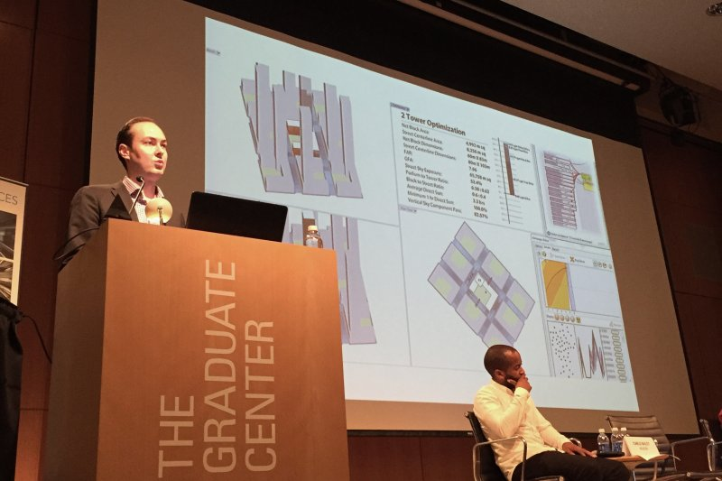
Spatial Analysis
KPF, Luc Wilson
Skyline impact and window views
View to the building, within the 3D context

Slide 3
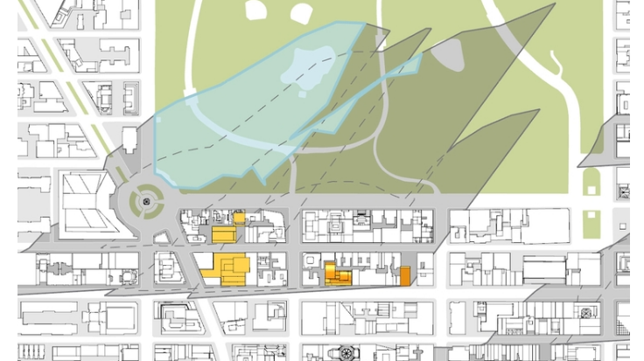

Slide 4
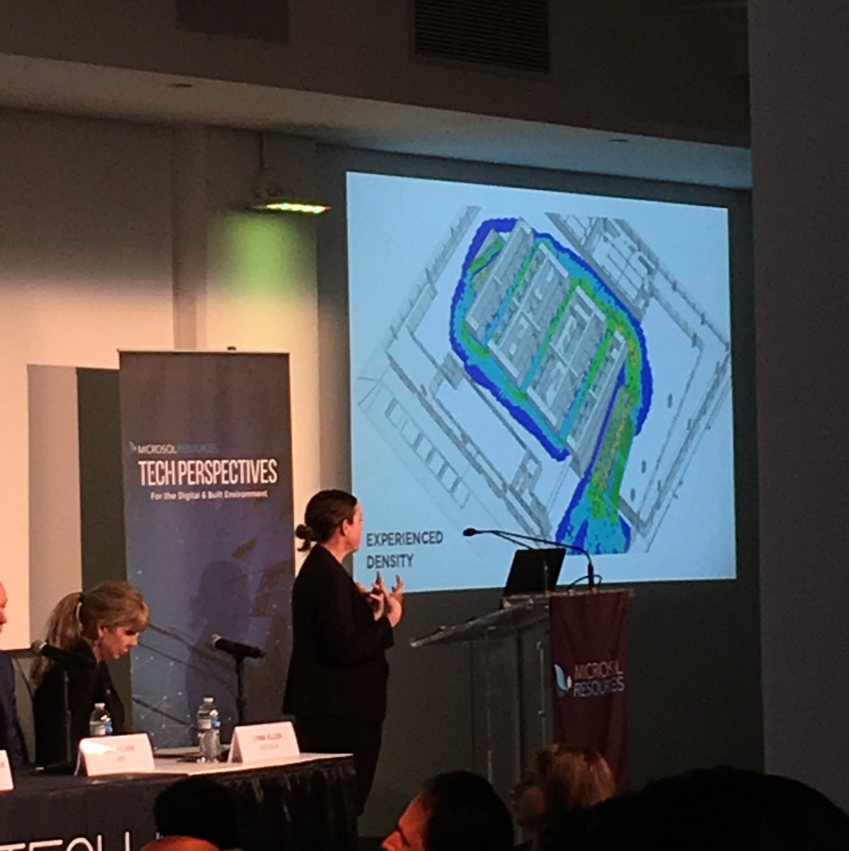
MassMotion
FXFowle, Alexandra Pollock
Retail use of vision mapping, density analyses

Slide 5
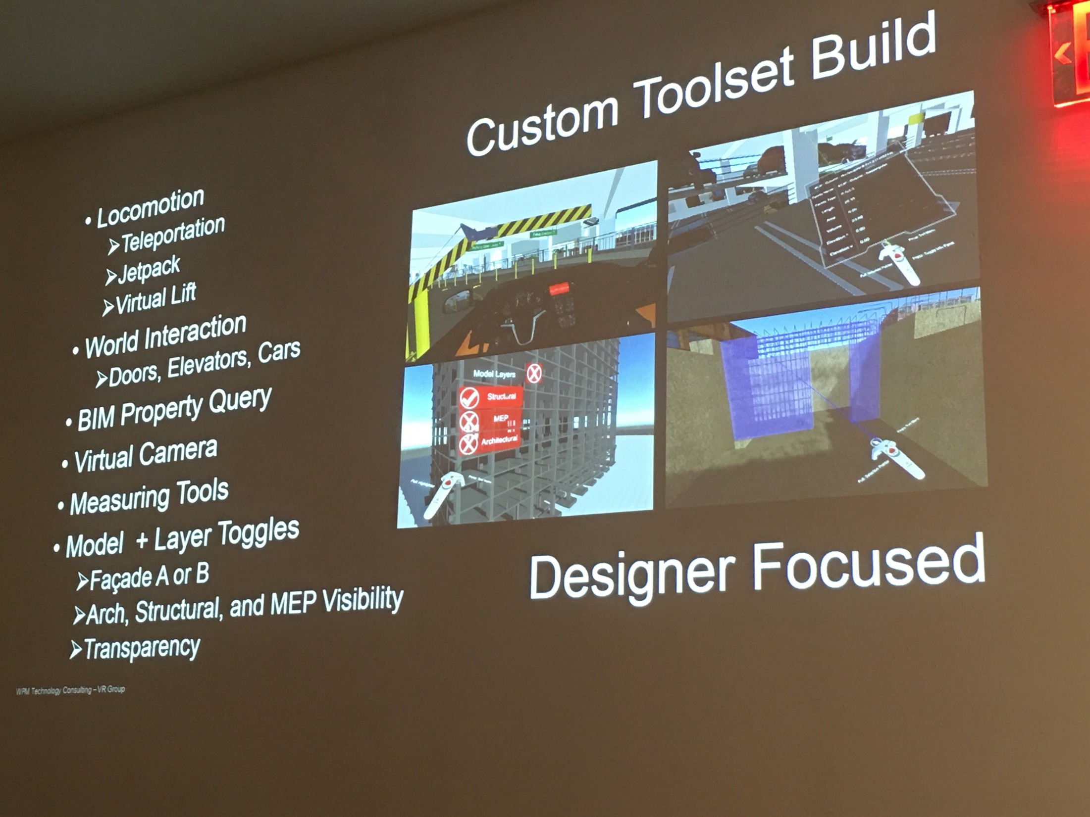
As a design tool
Walter P Moore, Jim Jacobi
Utilize Unity – game developer
Create custom HUD
Process takes less than one day
Cool or helpul?

Slide 6
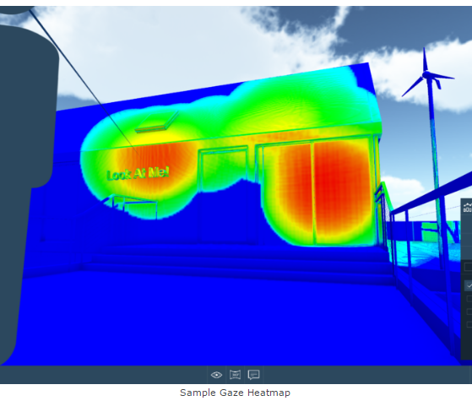
InsiteVR
Web-based tool to import 2D, 3D renderings and 3D models
VR within this paints a vision map of gaze
We are about to purchase a license from them for a year

Slide 7
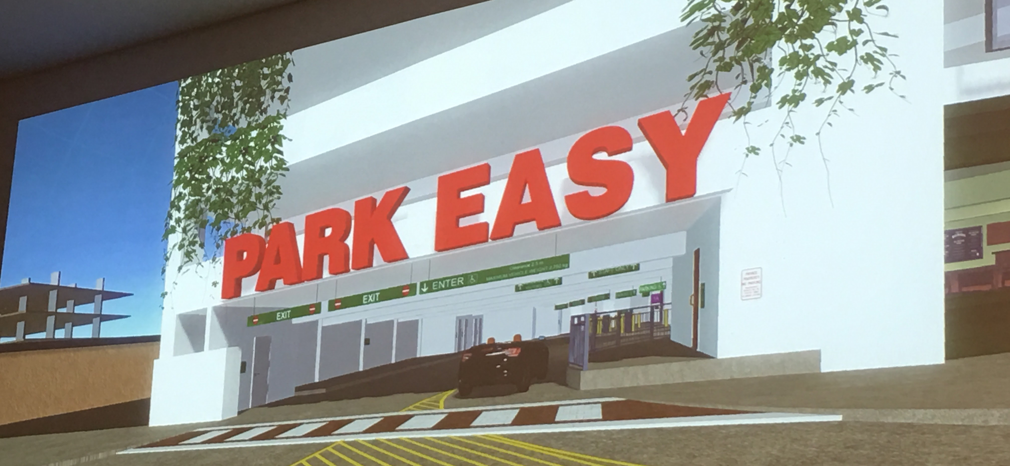
Medical/Retail Center

Slide 8
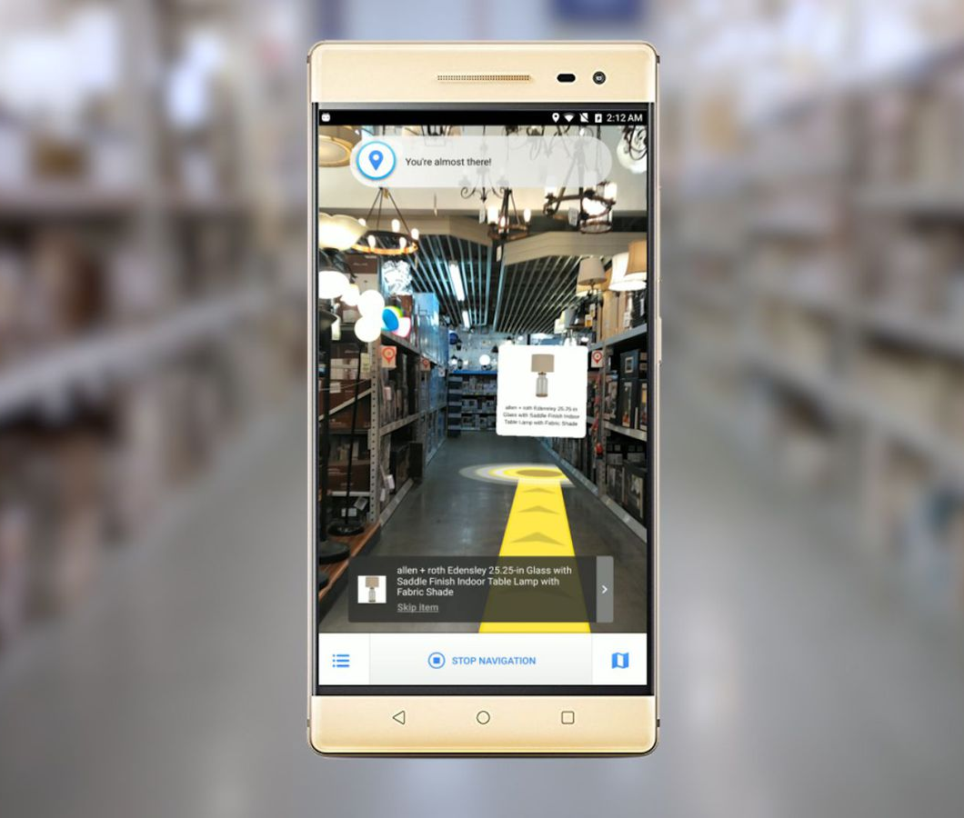
Google Daydream
Google, Aaron Luber
Google Tango – augmented reality enabled phones
Lowe’s in store mapping
Something similar? Airports etc.

Slide 9

Keynote
Hao Ko, Gensler
Nividia new headquarters in Silicon Valley

Slide 10
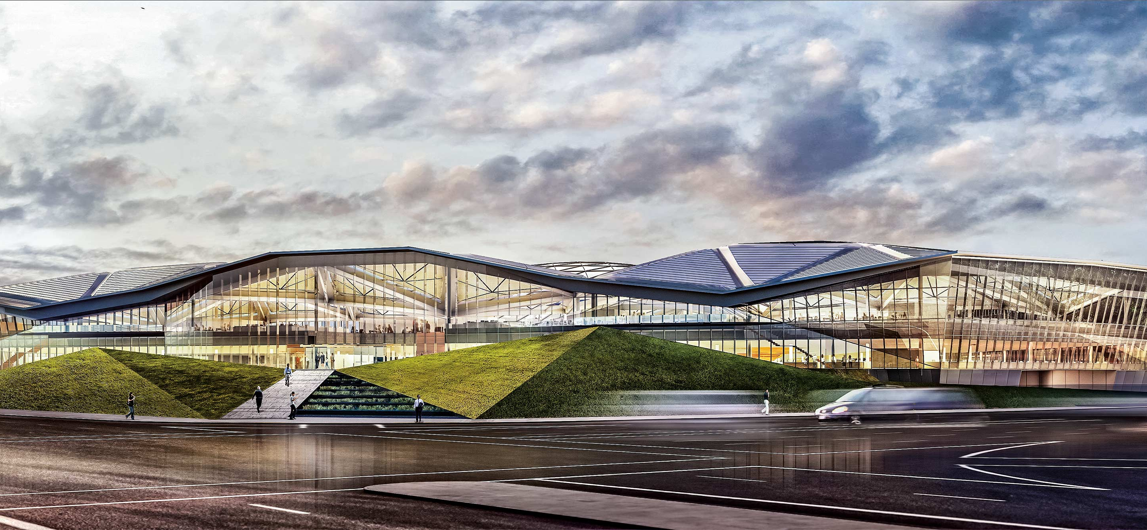
NIVIDIA HQ

Slide 11
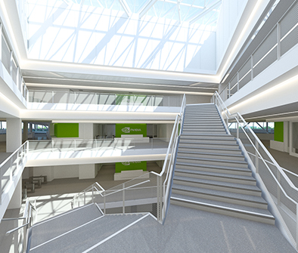
Keynote
Gen-Hsun, CEO of NVIDIA
Design computer chips
Do not just design then send to manufacturer
Tested, pushed to capabilities, re-designed, refined

Slide 12
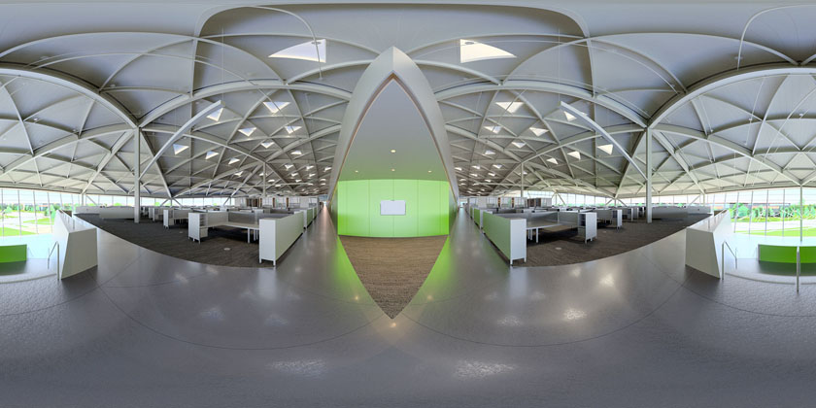
NIVIDIA HQ VR
Notes:
Helped with narrowness of a gap with between furniture, removed a wall due to this. Wasn’t caught on the plans

Slide 13

Carmera
Large scale data collection
LIDAR scanner on car roof
Rooftop cameras recording as freight moves through the city
Refresh in some areas daily

Slide 14
Carmera
Privacy reasons have to blur faces
Gives ped count
Heatmap of pedestrian activations
Currently negotiating to come to Arup

Slide 15
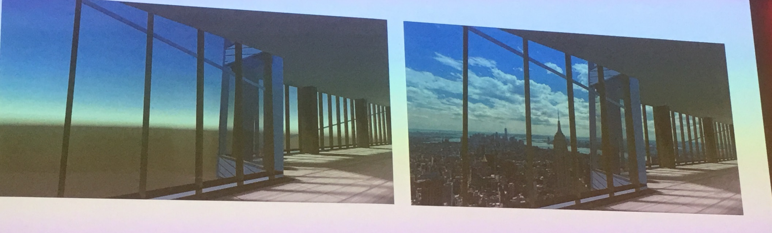
Using Drones
Drone at a certain height
Layer this into 3D model

Slide 16
Themes
Have some good technology, no one quite knows what to do with it though
Focusing on design at the moment rather than the interaction with the space
Dynamic movement in VR models is an opportunity
Wayfinding is an opportunity
First year, not great, just a product pusher

